Slide 1


Choose New Brunswick?
Develop a Solution
Notes:
*Note For Educators* Start your presentation with this slide
Before you begin the workshop, consider going through the key terms worksheet
We’ve left the transcript from the video recording of this presentation throughout for you to refer to as speaking notes
TRANSCRIPT:
-----
Welcome back! So awesome to see you again. We are back for workshop 3 where we are developing a solution to the challenge.

Slide 2

Agenda
1. Engage
2. Explore
3. Explain
4: Elaborate
Refamilizarize ourselves with the challenge
Think about what it means to live and work in a place
Understand what makes a good solution.
Choose a solution, and develop a plan to create an example
Notes:
TRANSCRIPT:
-----
In our workshop today, we’ll refamiliarize ourselves with the challenge, think about what it means to live and work in a place, and understand what makes a good solution. We’ll choose a solution (in groups, or as a class), and develop a plan to create an example of the solution. There’s lots to dig in today, so let’s get started.

Slide 3

01
ENGAGE
Notes:
TRANSCRIPT:
-----
Let’s engage our brains and remind ourselves about the challenge is, from John.

Slide 4
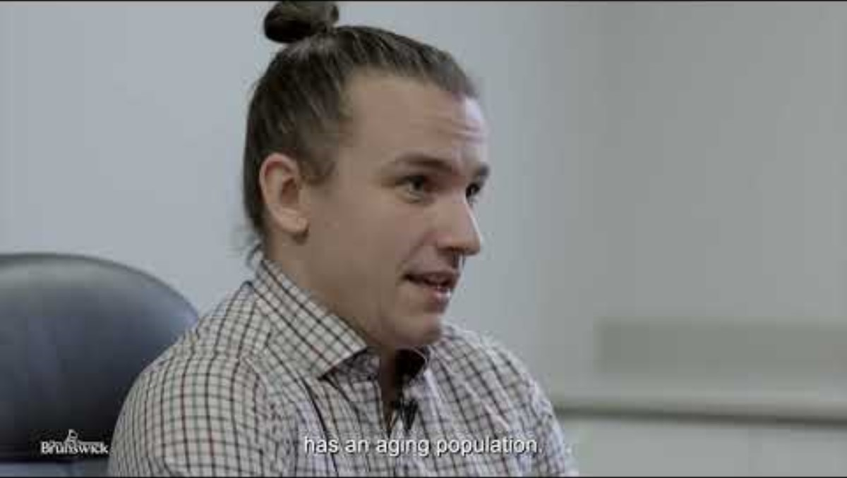
Recap: The Challenge

Slide 5


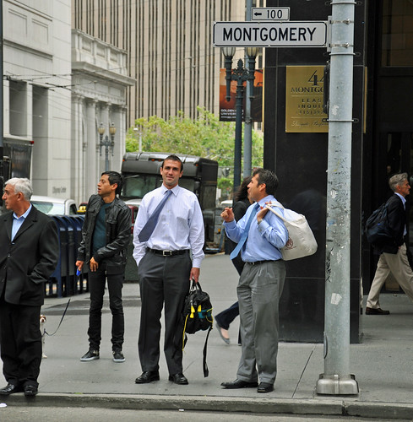
Ask Around
Why is it important that people choose to build their careers in New Brunswick?
What makes a city or region appealing to live and work in?
Moving on!
Notes:
*Note for Teachers* There is an extension activity you might find useful here. It’s a short reflection on an article titled “What is a ‘good’ job” from the Labour Market Industry Council. It may be useful if students are wondering what the components of a ‘good’ job are.
GUIDING QUESTIONS
Why is it important for people to work in New Brunswick?
What things make a city or area a good place to have a job?
Can you name some good things about working in a certain city or area?
How does the number of jobs available affect where someone might want to work?
What are some important features that make a city or area a nice place for a job? These could be activities, but they could also be organizations, or events.
Why is it helpful to have friends and connections when working in a place?
Are there specific types of jobs that characterize New Brunswick?
What are some problems people might face when choosing to work in New Brunswick?
TRANSCRIPT:
-----
Take about 3 minutes and discuss with your teacher and your class these two questions: Why is it important that people choose to build their careers in New Brunswick? And what makes a city or region appealing to live and work in?
Press pause here, and when you’re ready, press play. A green bar with the text “moving on” will appear before the next slide.

Slide 6

What we think and know
Working locally can make big (provincial) impact
It can be all about a person’s work-life balance
When we look for information to help us make decisions, John and his team in the government offers us resources
Notes:
TRANSCRIPT:
-----
When you work in New Brunswick, you're not just earning a paycheque for yourself. You're contributing to the growth and prosperity of local communities. Your job helps businesses thrive, which, in turn, supports the economy in the province. Working in New Brunswick also often means that you’re living there. You are participating in a community – it’s like you’re part of a big, local team. You actively contribute to the well-being and progress of others, and make a positive mark on the place we call home.
Some of the things that make a city or region a good place to choose to build a career is the work environment. A good job where people are paid well, have great benefits, aren’t overworked, and where they feel as though they’ll get promoted in the future are a few things that make a ‘good job’. You will spend most of your life working, so being happy and comfortable with your job’s tasks, and with the people you work with is key. A person’s life is improved when they are able to access essential services and recreational activities close to where they lives and work.
Sometimes, finding the ‘perfect’ job can be tricky, and a person may need to take a ‘for now’ job. And sometimes it can be hard to access essential services, especially if a person’s career takes them to somewhere more rural where services aren’t as readily available. Overcoming these challenges often involves creativity and determination. In New Brunswick, we can use data and resources that John and his team create for us to make informed decisions about the work we want to do, and where the best place could be to have a particular job.

Slide 7
02
EXPLORE
Notes:
TRANSCRIPT:
-----
We’re going to explore some of the ideas that are already out there that we could consider suggesting or elaborating on or even creating your own unique solution to John’s challenge. We’ll start with an activity that gets us brainstorming fast.

Slide 8


Think-Pair-Share
Pair: Pair up with a partner or a small group and discuss your ideas from the "think" stage.
Share: Each pair or group will share their most compelling ideas with the class.
Think: Think about and research answers the following questions:
What is happening in other provinces that make people want to live and work there?
What could be developed to make New Brunswick the best place for people to choose to live and work?
In the THINK phase, it may be helpful to consider a perspective that is meaningful to you (an occupation, or a community issue)
Moving on!
Press PAUSE and discuss.
Notes:
*For Teachers* Detailed instructions on the Think-Pair-Share activity can be found here: https://www.kent.edu/ctl/think-pair-share
It is recommended that Think, Pair, Share take about 30 minutes
THINK
Students will reflect and research on the following two questions (one question optional if students are inclined to respond or consider arts, culture, and the outdoors).
What is happening in other provinces that make it appealing for people to choose to build their careers?
What [services, programs, advertising campaigns, or resources] could be developed or implemented by PETL to make New Brunswick more appealing to young professionals?
(optional) What are some potential events or activities that could attract young professionals to New Brunswick?
PAIR:
Pair up with a partner or a small group and discuss your ideas from the "think" stage. Consider each other's suggestions and combine your thoughts to come up with even more innovative strategies.
SHARE:
Each pair or group will share their most compelling ideas with the class. Encourage discussion and ask for feedback from peers to refine the strategies further.
TRANSCRIPT:
-----
There are three steps to this activity: Think, Pair, and Share. In Think, you’ll reflect on and research your responses to questions independently. In Pair, students partner with others to discuss their ideas, and come up with more innovative strategies. In Share, each group of students will be asked to share their best ideas that they thought up, or created as pairs with the class.
Press pause here, and when you’re ready, press play. A green bar with the text “moving on” will appear before the next slide.

Slide 9
What we learned and discovered
What is happening in other provinces that make people want to live and work there?
What could be developed to make New Brunswick the best place for people to choose to live and work?
Notes:
TRANSCRIPT:
-----
In your short discussion you might have thought of some really awesome ideas based on these two questions.
Question 1: What is happening in other provinces that make people want to live and work there?
This question prompted us to explore what's drawing people to build their careers in other provinces. It was an an opportunity to learn from the success of others, and think about if any of these ideas could be a solution in New Brunswick. We might have thought of or noticed Recruitment programs. Recruitment involves tools that help employers find workers. Poster, videos, or top of the line training could be some recruitment strategies. You may have also looked at retention resources. Retention helps employers keep workers who may be looking for other jobs even though they have one. Special training that helps someone get a promotion, benefits like extra vacation time, or increased wages at regular check in times – these are all part of retention.
Question 2: What could be developed to make New Brunswick the best place for people to choose to live and work?
Was all about brainstorming and imagining the ideal conditions that would make New Brunswick the best place to create a great life and have a great job. You might have thought about what it would mean to create new services, launching new programs, designing impactful advertising campaigns, or developing valuable resources that can help someone get the kind of job they want without being confused. It encourages us to think creatively about shaping New Brunswick labour market into a place that stands out.

Slide 10
03
EXPLAIN
Notes:
*For Teachers* If you are looking at the time, and thinking you may run out, pausing here and resuming the workshop on a different day is great. Spend more time on Think-Pair-Share and return here for a natural restart.
TRANSCRIPT:
-----
So what makes a good solution, and how do we know when we have a solution that we can really create for ourselves? How do we know when we can create an example?

Slide 11



Possible solutions
When we are trying to decide on a solution we need to consider:
Who
How
Why
How will this solution look in real life?
How does this solution make a difference?
Why is this solution a great idea?
Who is this solution for?
Notes:
TRANSCRIPT:
-----
When we are Consider "who." Who is this solution for? Identifying the right people your solution is for is the best place to start. Your solution could be just for youth in your economic region, or it could be just for youth looking to build their career in the trades. Who is going to benefit most from the solution you create.
A solution always needs a "how." How does this solution translate to real life? Visualize it. Picture the practical steps and imagine the positive impact it could have. The "how" is about turning ideas into action, making a tangible difference. How could look like a petition to government, a new community workshop, or a new website or a series of promotional Tik Tok videos.
And last, think about "why." Why is this solution fantastic? Why does it matter? Make a bold statement about why your solution is awesome, the best, magnificent and spectacular!
Who, How, and Why form the bones of a solution statement that you can use to pitch and communicate your idea to others. You’ll be doing that in your class, and potentially to the people at PETL who are waiting for your awesome ideas.

Slide 12
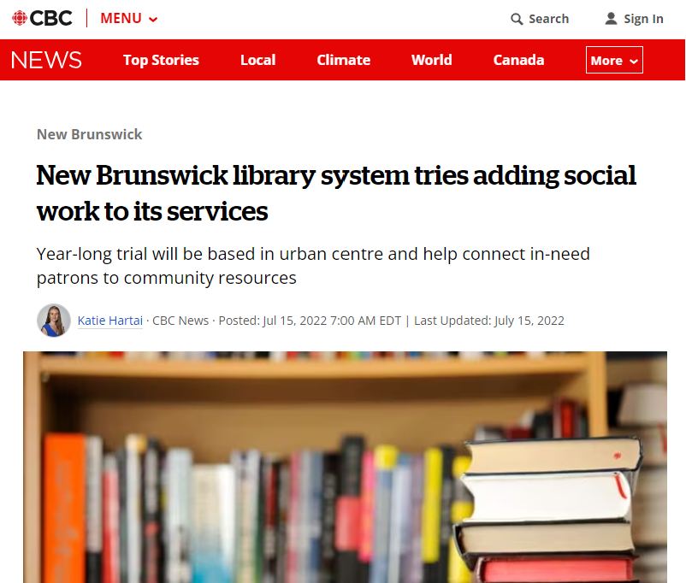
A solution to this challenge
https://www.cbc.ca/news/canada/new-brunswick/social-work-public-library-1.6520725
Notes:
CBC Article Link: https://www.cbc.ca/news/canada/new-brunswick/social-work-public-library-1.6520725
TRANSCRIPT:
-----
Let’s take a look at a solution that PETL has already created. This news article shares one of the ways that PETL has worked towards addressing a challenge similar to the one we’re solving..
New Brunswick Public Library Services launched a year-long pilot project in 2022 to hire a bilingual social worker. The social worker, based in Saint John, Moncton, or Fredericton, connected library visitors with community resources and access to employment support. The project, aimed to support library visitors dealing with complex life issues including unique needs around jobs and community services.

Slide 13
Solution: Social Workers in the Library
Who
People who go to the library
Public libraries and librarians
Social workers
A social worker at the library will best connect people with services (including employment) in the community
How
Solution Statement: Bring social and employment resources closer to the people who need and use them.
Everyone is welcome at the library
Librarians aren’t trained social workers
Community services can be hard to find and access for some people
Why
Notes:
TRANSCRIPT:
-----
When we think of this solution, bringing social workers into the library, we know the who. We know that the solution is for people who go to the library. We know the how: a social worker would collaborate with librarians helping people find work and other essential services, or community resources. We also know why this is an awesome idea. Lots of people different people use the library, and librarians aren’t trained to do social work. By offering new services at the library, many different people who really need community or social services are better connected to the resources that help them most.
The solution statement for this solution could potentially have been “Bring Social and employment resources closer to the people who need and use them”.

Slide 14
04
ELABORATE
Notes:
TRANSCRIPT:
-----
Over the past two workshops, we’ve had a chance to look at all kinds of opportunities in New Brunswick’s labour market and for the future. In our next workshop, you’ll learn how to pitch your solutions to your class and teacher. Right now, we’re totally focused on choosing a solution, and planning for how to make the solution happen.
Your teacher might offer you time to work on implementing your plan in class over the next few days. It’s going to be awesome, you’re going to get to be so creative.

Slide 15
Choosing a Solution
Think about a solution to this challenge, not the solution.
Keep it doable. Make a plan.
Meaningful to you, and to others.
Notes:
TRANSCRIPT:
-----
When you are choosing a solution as an individual, small group, or as a classroom, we want you to make the challenge your own! There is no expectation that your solution is going to wave a magic wand and solve everything for everyone (that’s why we think of ‘who’ the challenge is for). What I’m encouraging you to do is to think back over our workshops, look back at the worksheets you’ve completed, and choose a solution that is specific. Your solution should have answers to “Who”, “How” and “Why”. There are hundreds, if not thousands of different ways to think about this challenge – as many solutions as there are people, occupations, and employers in New Brunswick.
Keeping it ‘doable’ is so important because you are showing the government of New Brunswick that it is totally possible to make your solution happen. It’s easy to say “increase the minimum wage! That’s the solution!”, but in the real world when we’re solving this problem it’s not so clear cut. How can you make your solution implementable? What can you create as an example that could show the government how to implement your solution in the real world.
Choosing a solution that is meaningful to you, and to others is going to show. Being able think about and express why the solution is valuable and impactful will help you share your solution effectively with others. When our solutions are meaningful, they resonate, inspire, and drive positive change. It's the difference between just solving and truly making a difference
Let’s take a look at an example solution

Slide 16




Example Solution: Youth Zine for your City/Town
Notes:
*For Teachers* What’s a Zine? – a zine is a DIY self published, non-commercial, small magazine that in the past has celebrated unique lifestyles or perspectives. They’ve typically been made using collage and a photo copier, but could be an email newsletter, or a carefully folded and stapled together book.
TRANSCRIPT:
-----
Here’s an example scenario and solution: Students Lauren and Casey were exploring different careers in their French class, thinking about what it would be like to have a job. Summer was coming up, and they would have full days earn money for a school trip to Quebec City next year. Lauren’s and Casey’s parents agreed that their famil would help pay for half, but only if they earned their own money this summer. Casey’s dad owned a farm and hired people to pick fruit in the summer and work at the farm stand. Casey and Lauren wished they had somewhere to go that would quickly and easily show different job opportunities available to students their age that they liked instead of working for Casey’s dad. They wanted this information ‘place’ to be cool, and welcoming. They wanted a list of places to work, so that it didn’t take too long to find a job, even though they had never had one before. They knew about NBSEED, a summer jobs program for employers who hired students. NB SEED had some job listings, but the site didn’t include all the employers that hire students in their town – only employers that are part of the SEED program.

Slide 17
Example Solution: Youth Zine for your City/Town
Students who wanted to find summer jobs in their town.
Who
A zine created by youth with creative articles and poetry about their town, in addition to information on volunteering
How
Solution Statement: Create local, youth-friendly space that shares information on summer jobs for students in their town.
Information on student summer jobs has to be student friendly so that students know where to look for work.
Why
Notes:
*For Teachers* What’s a Zine? – a zine is a DIY self published, non-commercial, small magazine that in the past has celebrated unique lifestyles or perspectives. They’ve typically been made using collage and a photo copier, but could be an email newsletter, or a carefully folded and stapled together book.
TRANSCRIPT:
-----
To solve this challenge, they created their solution statement: Create a local, youth-friendly space that shares information on summer work for students in their town.
They identified who their solution would be for: students looking for summer work. They gathered as much information as they could about summer work for teens by talking to their friends to learn where they were working, asking older students and their older siblings what they did for summer work. They asked lots of employers at the mall, downtown, and at community centres or churches if they hired students their age to work during the summer.
They knew how, by delivering a local zine that lots of students in their town would find relevant. They created and printed out their zine on a big sheet of paper, folded it in half so it looked like a thin newspaper, and asked to display their zine where other interested students could see it: the school office, the library, the rec centre, and the Tim Hortons by the mall.
They knew their why: The information to find student friendly jobs wasn’t actually student friendly. It was easier to find jobs they weren’t qualified for than it was to jobs they were qualified for. Something had to change.
After doing all this work, they can really see this idea expanding into an online newsletter, or an annual “Teens Work” bulletin board at the local WorkingNB office.

Slide 18
Examples of Solutions You Could Consider
Create an infographic to help people learn about how to pursue a specific career in New Brunswick
Create a video, or a social media campaign that encourages employers to hire youth
Write an arts and culture brochure or events calendar for your city/region
Create a way to celebrate employers who are doing a really great job
Create an advertisement, or an awareness campaign that highlights your solution
Work with an organization interested in developing a Youth Council to help with decision making.
Press PAUSE and discuss.
There are so many more solutions that you could develop! Think back to the previous workshops or to the Think-Pair-Share activity
Moving on!
Notes:
*Notes for Teacher* There is a resource of 100 PBL specific final products that your students could find really useful if they’re stuck on ‘how’ they are going to create their solution. If you are really stuck, please feel free to reach out to the Project Manager, Emily Worthen for ideas or a quick brainstorm.
TRANSCRIPT:
-----
Here are some examples of solutions that are totally doable, most of them just need a ‘who’ and a ‘why’ to create a really good solution statement to start from. There are lots more ideas out there, and if you’re stuck on “how” to create your solution, ask your teacher or brainstorm with other students! Many heads are better than one. Pause the video here and take a look at these different ideas. What else can you think of that you could add to this list, or that you want to try yourself!?

Slide 19
04
ELABORATE
Notes:
TRANSCRIPT:
-----
Over the past two workshops, we’ve had a chance to look at all kinds of opportunities in New Brunswick’s labour market and for the future. Your solutions will be shared and presented to your class and teacher.

Slide 20

Get Planning!
Define your Solution Statement
Understand Who, How and Why
Plan and Create your Solution
Notes:
TRANSCRIPT:
-----
Let’s get planning using a simple yet powerful guide for tackling solutions.
Step 1 - Define your Solution Statement. Take a moment to write down your one sentence solution to the challenge. This is like setting the destination on your problem-solving journey.
Step 2 - Understand Who, How, and Why. Who will benefit from this solution? How will the solution look in real life? And most importantly, why does it matter?
Step 3 - Plan and Create Your Solution. Now that you know your solution, and what it will look like, plan your example. What steps need to happen? What resources do you need? Who will do what? And who do you need to talk to? This is your roadmap to success, and your opportunity to get really innovative and creative.

Slide 21

Plan your Pitch
We want your solution, and your pitch to be as awesome as you are.
It won’t be like the real Dragons’ Den (we promise)
Notes:
TRANSCRIPT:
-----
Once you have planned and created your solution example, you will learn to pitch your idea, just like on Shark’s Tank or Dragon’s Den! You will pitch your idea to your class. This pitch will show off what you’ve created. We will learn more about what it means to pitch in our next workshop, but for now it’s time to make your solution statement and example the best they can be!
Educator, your students are beginning to working on a pitch and a plan. You might want to consider the time you have for students to implement their plan and get their creative product finished.

Slide 22
See you soon in Workshop 4!
Notes:
TRANSCRIPT:
-----
Thanks for taking this workshop with me! I cannot wait to see what your solutions are. In our next workshop we’ll talk more about what it means to pitch your solution, and you’ll have an opportunity to practice with your class and teacher. See you soon in workshop 4.

