Slide 1
Choose New Brunswick?
Investigating Opportunities
Notes:
Start your presentation with this slide
-----
Welcome back
Last workshop we learned about the challenge that John from PETL wants us to find a solution for. We learned about the different ways that the Government of New Brunswick supports learning, work and the labour market. We learned about the different initiatives that the government has been trying, and we may have started to explore what other provinces are doing to support learning, work, and the labour market in their region. In our workshop today, we’ll think about our future career, and how a potential solution that could be developed would impact us. In order to tackle this challenge and find really effective solutions as part of this challenge, we need to look more at labour market information that is meaningful to you. …

Slide 2
Agenda
1. Engage
2. Explore
3. Explain
4: Elaborate
Think about our own career choices
Explore the opportunities available to us in the labour market
Together, share the opportunities (or lack of opportunities) for your career choice
Using what you’ve learned so far, explore new opportunities outside New Brunswick
Notes:
---
In our workshop today, first, we'll break down what we already know about the challenge. Then, we'll see how it plays out in the real world. Next up, we'll figure out what this challenge means for our future. And finally, let's check out what people and organizations are already doing to tackle this challenge.

Slide 3
01
ENGAGE
Notes:
--
TRANSCRIPT:
Let’s get started by thinking about ourselves, how we want to find a career, and how we want to build a career.

Slide 4
Your Career and You
Notes:
This video shares some stories of people who already are established in their careers. Their stories touch on why they chose their work, and what excites them!

Slide 5
Ask Around
When you think about your current career choices, what kind of opportunities do you see for yourself in New Brunswick?
Moving on!
Press PAUSE and discuss.
Notes:
Guiding Questions:
How do you think New Brunswick's current job market aligns with the career goals of high school graduates?
Can you identify any specific industries or sectors in New Brunswick that are thriving and may be attractive to young professionals?
What factors do you think contribute to young talent leaving New Brunswick for opportunities in other provinces or countries?
How might the availability of cultural and recreational activities impact the decision of young individuals to stay in or leave New Brunswick?
Do you think there are any misconceptions about the job opportunities in New Brunswick that may influence young people's decisions to stay or leave?
What initiatives or policies do you think the government could implement to encourage young talent to build their careers in New Brunswick?
--
We’ll pause and have a conversation with your teacher. They have some guiding questions that will help us brainstorm. Take 10 minutes to brainstorm together. Press pause here, and when you’re ready, press play. A countdown will show us when we’re moving on in this workshop.

Slide 6
What we think and know
Some careers may take us outside of the province to get started.
There are a lot of myths and beliefs about careers that people have that can influence our career choices.
When we look for information to help us make decisions, John and his team at PETL offers us resources.
Notes:
*Note to Teachers* There is a video available in the Extension activities that speaks directly to the second point. It is titled “Breaking career myths”. You may find it helpful to share here.
Breaking Career Myths – GNB: https://www.youtube.com/watch?v=u_vdkQrXIs8
TRANSCRIPT
It’s important to recognize that some careers may lead us beyond the borders of our province when we're just starting out. This means being open to opportunities beyond our immediate surroundings, embracing the adventure that comes with pursuing certain career paths. Being open to moving doesn’t mean that we shouldn’t explore the opportunities around us.
Exploring the labour market around us is a great first step to explore our career opportunities. Families, friends and community members are great places to start asking questions. It is important to remember that they might not know about the labour market. They might not understand what you want to do for work in the future. There are a lot of myths and beliefs about jobs and the world of work, and a lot of these are old and irrelevant to our changing world. That’s why we need to look at different sources of labour market information, and not only rely on what someone else’s opinion is.
When we explore and gather information to make informed decisions, we have a valuable ally in John and his team in the government. They provide resources to guide us through the maze of career possibilities, offering reliable insights to support our decisions. These may be easy to find, or they may be something entirely new to us.
Wherever our paths lead us, remember: we're not alone. We have resources, insights, and a world of possibilities at our fingertips.

Slide 7
02
EXPLORE
Notes:
--
TRANSCRIPT:
Let’s get exploring the labour market information that is meaningful to you! As you’re exploring, look for opportunities that could start to form the foundation of a potential solution that you develop.

Slide 8
Using Labour Market Information (LMI)
When we are exploring our own opportunities using labour market information, we can look at:
Sectoral or Industry information
Occupation Information
Real World examples (People, Print, Participation)
Moving on!
Press PAUSE and discuss.
Notes:
When we are exploring labour market information, we can look at many different sources. Sectoral or Industry information, and Occupation Information can be found on NBJobs.ca, or Job Bank, the federal government website. We can also look at Labour Market Information from other provinces. Using Real World information found in conversations we have with different people, print resources, and by participation (volunteering and job shadowing for example) can also be great sources for gaining labour market information.
Take some time to look at New Brunswick’s Labour market information, and learn all that you can about a career of your choice here in New Brunswick. The worksheet will walk you through all the big stuff. Pick a career that interests you. It can be a career that you know you want to do, or it can be a career that you want to know more about.
You can complete this worksheet in small groups, or as an individual. Teachers, you may find it helpful to divide the class into small groups who want to explore a similar job. Take about 20 minutes to complete this worksheet. It will go super fast if you research as a team. If you can’t find an answer to something, consider who you could ask to find an answer.
Press pause here, and when you’re ready, press play. A countdown will show us when we’re moving on in this workshop.

Slide 9
03
EXPLAIN
Notes:
--
TRANSCRIPT:
Let’s think about what it means to find and use labour market information.

Slide 10
What we learned and discovered
Labour market information is everywhere!
We can learn a lot about ourselves, and the place we live using labour market information.
Making career choices informed by labour market information can set you up for success.
Notes:
Labour market information truly is everywhere. Sometimes it is easy to find on websites and in reports, and sometimes it can surprise you in a conversation you have with another person! Understanding what labour market information is, and how it can be used to support your career decisions, can be an incredible skill that you can use every day of your life.
Labour market information can be used to inform our choices, and it can also help us paint a picture of the world around us. We can tell a lot about a region based on the labour market information. For example, in capital cities like Fredericton, the labour market information will point to more employment in provincial government, and more opportunity to work in business and infrastructure. In coastal towns you may see people employed more in fisheries or in oil and energy. We can also learn about potential opportunities for work as different learning or work initiatives are announced that support people a need in the labour market, and helping a person gain employment.
So, why is it so important to match our career dreams with the labour market opportunities out there? Well, it's like having a map for your journey. Imagine charting a course, putting in the effort, and working towards your dream career, only to find limited opportunities. This misalignment can be frustrating and can affect our wellness long-term. What happens when you can’t see an opportunity to pursue your chosen career in the current job listings or government reports? How does it feel, and how might it influence your goals and plans? Labour market information is a tool that can help you understand these influences, and support you to make choices that are meaningful to you.

Slide 11
What kind of opportunities can LMI show us?
Notes:
An alternative video if you or students are interested is the Career Connected Learning LMI video from the Department of Education and Early Childhood Development.
Career Connected Learning – EECD: https://www.youtube.com/watch?v=LjqoIp1RjZA

Slide 12
Using Labour Market Information Responsibly
When using and interpreting LMI, we need to consider whether or not the LMI is:
Reliable
Relevant
Recent
Notes:
GUIDING QUESTIONS:
Why would we consider the reliability, relevancy, or the timeliness of information we are reading?
What shows us that a piece of LMI is reliable? Relevant? Recent?
----
TRANSCRIPT: When using LMI, it is important to make sure that the information that you research is 3 things: Reliable, Relevant and Recent.
Reliable information comes from a trusted source, not just one person or organization’s opinion. Relevant information actually addresses your research, is meaningful and not “close enough”. If you’re interested in a job as an electrician, relevant labour market information wouldn’t include other trades like carpentry or hairdressing. Recent information is up-to-date, and informed by real events in the world. For example, a grandparent’s experience getting a job 50 years ago is totally different than what you will need to do in the future.

Slide 13
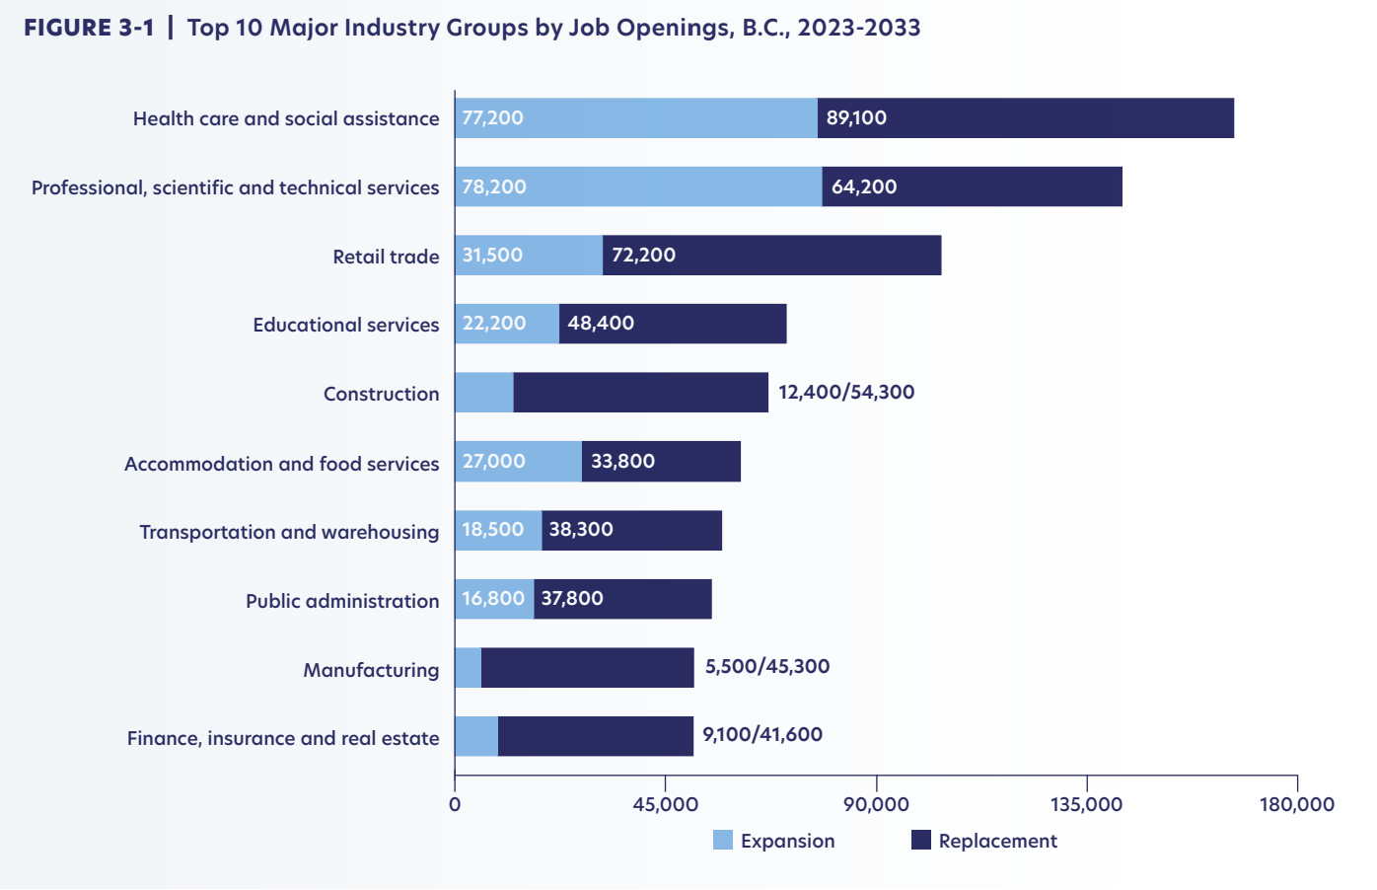
Forecasted Job Openings by Sector (2023 to 2032)
British Columbia
New Brunswick
Notes:
When you use Reliable, Relevant and Recent labour market information, you will be able to find valuable information with a different perspective. Here we have two similar charts that share industry information for different provinces (British Columbia and New Brunswick). Each chart shows the kind of jobs that are going to be available in the next ten years from people either retiring, or from new jobs being created. This labour market information can tell us that in British Columbia new jobs are being created in Educational services (jobs like teaching, school counsellors, principals). When we look at New Brunswick’s chart, jobs in educational services are forecasted to have jobs available only as people retire. A BC teacher in 5 years could be replacing a retiring teacher, or doing a job that is being created today. In contrast New Brunswick teacher would be replacing a retiring teacher.
What could this tell us about the opportunities for people choosing to build their career in education there in British Columbia? When we think about the challenge that John and PETL are asking us to find a solution for, what could government do to create new jobs in New Brunswick? BC is doing it, what could new Brunswick be doing? Asking questions like these as you look through LMI could open up a world of possibilities when we are brainstorming to create a solution.

Slide 14
04
ELABORATE
Notes:
--
TRANSCRIPT:
Let’s elaborate on what we’ve learned so far and think outside the opportunities in New Brunswick!

Slide 15
Look Outside NewBrunswick
As you are completing the worksheet, keep an eye out for labour market opportunities that could be developed into a potential solution for John’s challenge
In groups, take time to look at another province’s LMI for the same job you looked at before.
Moving on!
Press PAUSE and discuss.
Notes:
---
TRANSCRIPT:
Consider the career and the industry you’ve researched and compare it to the labour market opportunities in other provinces. You might notice that the opportunities are completely different. The wage might be higher, there could be fewer jobs, or you might find that there’s a perfect program in another province that doesn’t exist at all in New Brunswick!
Press pause here, and when you’re ready, press play. A countdown will show us when we’re moving on in this workshop.

Slide 16
What we learned and what we saw
What stood out to you?
What do you wish existed that would better support your, or your classmate’s career goals?
Can you see an opportunity for John at PETL, a community or sector organization, or yourselves to solve the challenge?
Notes:
GUIDING QUESTIONS:
What stood out to you?
What do you wish existed that would better support your, or your classmate’s career goals?
Can you see an opportunity for John at PETL, a community or sector organization, or yourselves to solve the challenge?
---
TRANSCRIPT:
As you compared your researched career to Labour Market Information in other provinces, what stood out to you? Did you notice any differences or similarities in the labour market trends? Reflecting on these thoughts and observations allows us to understand from a bird’s eye view the potential impact of the labour market on our career choices.
Now, from your own perspective, what do you think could be a potential cool solution or resource that could be developed that could enhance your career goals? Think not only about the current situation, but also about what you wish could support your career choice, whether it exists or not. Are there specific elements, support systems, or opportunities that you believe would enhance your chosen career, especially if they're not currently available in New Brunswick or are present in other provinces?
This is the creative part – envisioning a future for your career path. What do you wish existed to better support your goals? Perhaps it's mentorship programs, industry-specific training, or networking opportunities. Maybe it’s bringing a youth specific voice to the decision-making table. Or maybe it’s something that would affect everyone regardless as to the industry, like ensuring affordable housing for people who are growing their careers – where the low or median income of people is considered when housing or neighbourhoods are developed. Your insights are valuable not just for your personal journey but also for identifying potential areas of growth and development in the labour market.
As we continue discussions like these, keep in mind that your perspectives contribute to a shared understanding of how we can shape the future of our careers and the careers of others. We’ll explore and plan for a potential labour market solution that can support career choice in our next workshop, and consider how we can work towards creating a New Brunswick that people choose to build their careers in.

Slide 17
See you soon in Workshop 3!
Notes:
Thanks for taking this workshop with me! I hope you got to learn about how labour market information is meaningful to you – that it’s not just charts and graphs. That it’s conversations that we have with others about our career hopes and goals.

